Slide 1
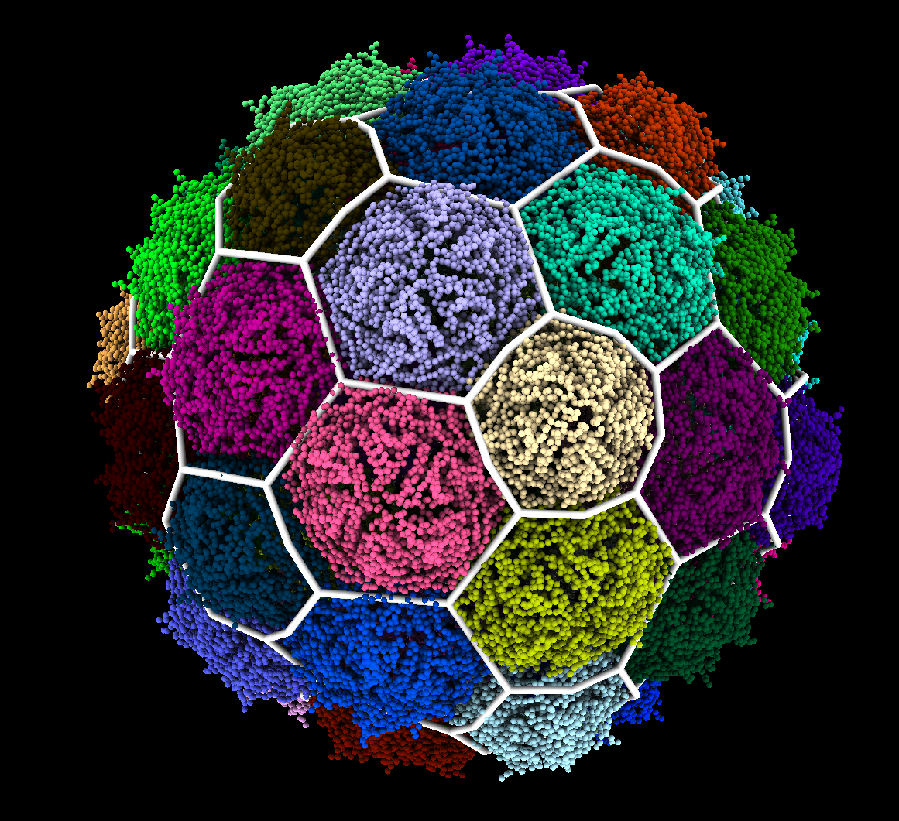

Structural Analysis & Classification Of HK97-like Viral Capsids
Colin Brown – MS Physics
Luque Lab

Slide 2
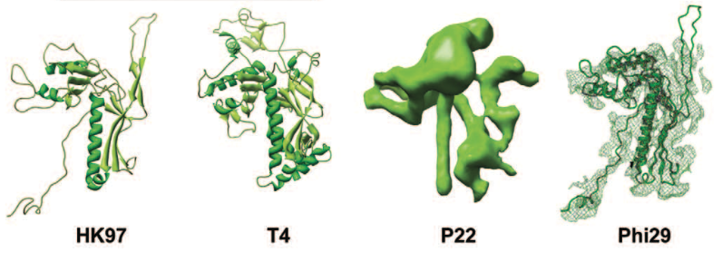
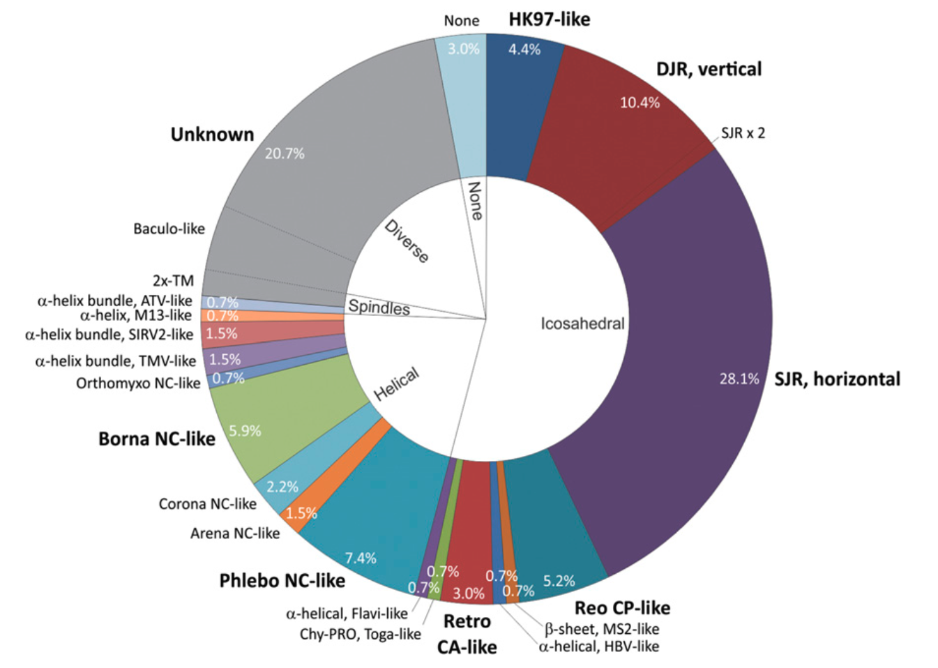
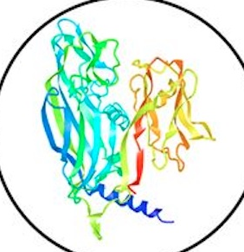
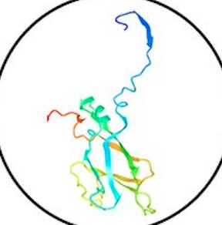
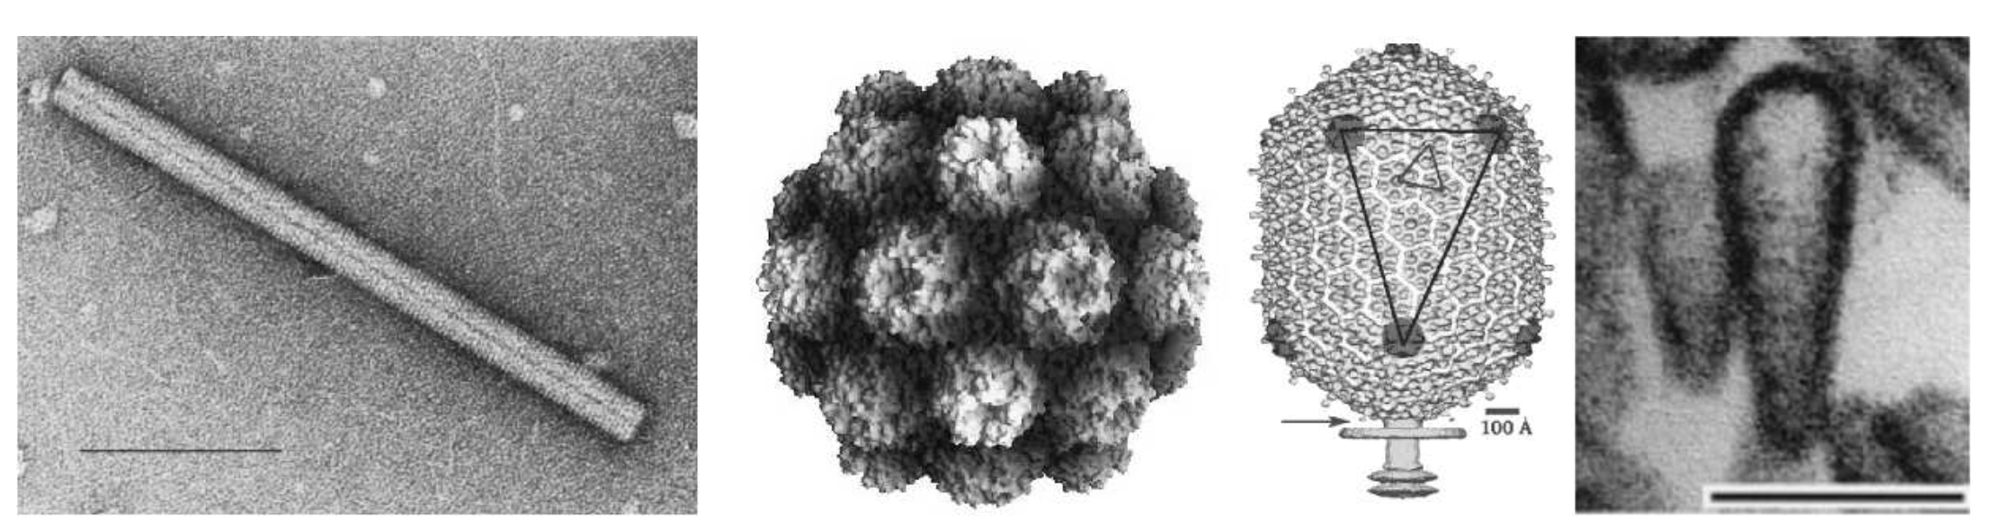
Icosahedral capsids dominate the virosphere
Viral Capsids
Contain the viral genome
Built from repeated units
Icosahedral Capsids
Highly symmetric
>90% of viruses
Krupovic and Koonin, PNAS 2017
ICTVdB
Notes:
Short into to viruses (30 sec)
Viruses, in order to spread, need to be able to transport their genetic material. They achieve this by building protein shells called capsids. To save genome space used to encode proteins, they are built from many copies of a single Major Capsid Protein and adopt symmetrical structures. (Reference figure as the different type of capsid proteins)
30 sec
Of the symmetries available to them Icosahedral symmetry is the most common and more than 90% of viruses on the planet adopt it. My research will focus on a particular variety of protein fold, that being the HK97 fold, which exclusively builds icosahedral capsids.

Slide 3
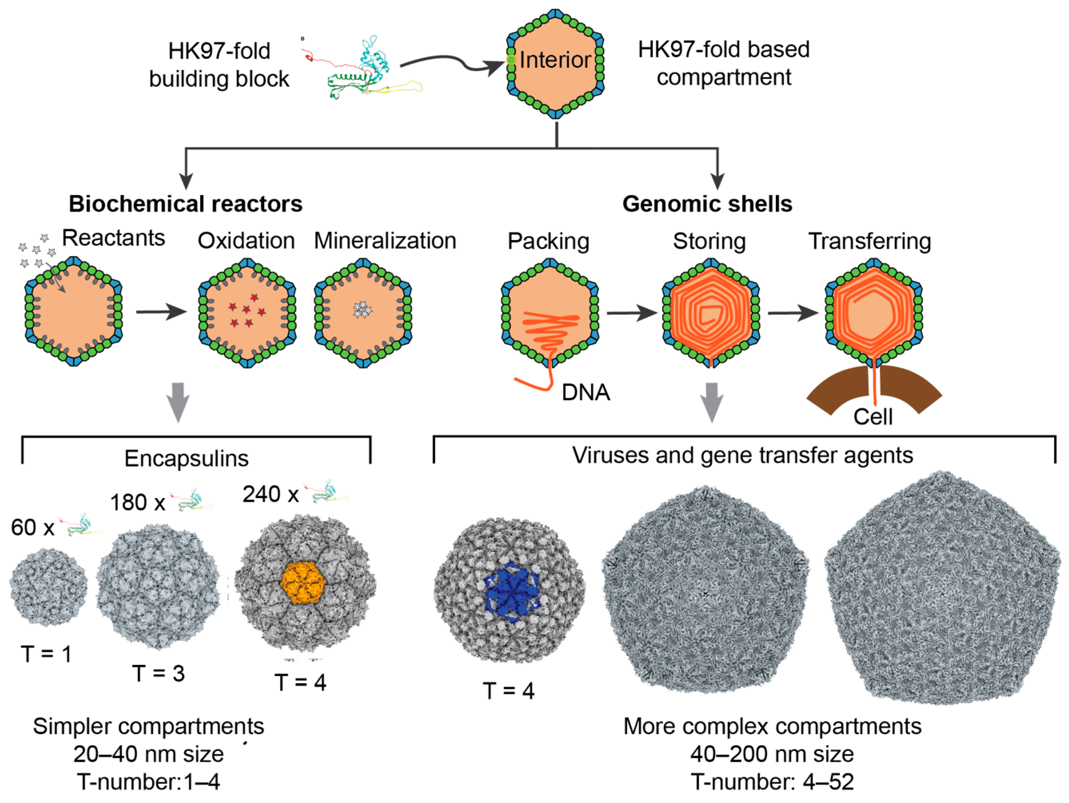
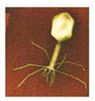
HK97-Like Folds
HK97-fold
Tailed bacteriophages
50%-90% of viral particles in the environment
Luque, Benler, Lee, Brown and White, Microorganisms 2020
Notes:
1 min
Variations on the hk97 fold fold are found in a variety of architectures, most prominently the tailed phages, but also Virus Like Particles called Encapsulins. These encapsulins are of interest because they represent the smallest structures built using an HK97-like fold. The smallest encapsulin has a diameter of 20nm and the largest capsids have diameters of approximately 200nm. Understanding the geometry of these structures, and how the hk97-fold builds them, could allow us to use simplified models to describe capsid dynamics, gives insight into how these viruses evolved, and could guide the development of engineered Virus Like Particles.
Most abundant lifeform.

Slide 4
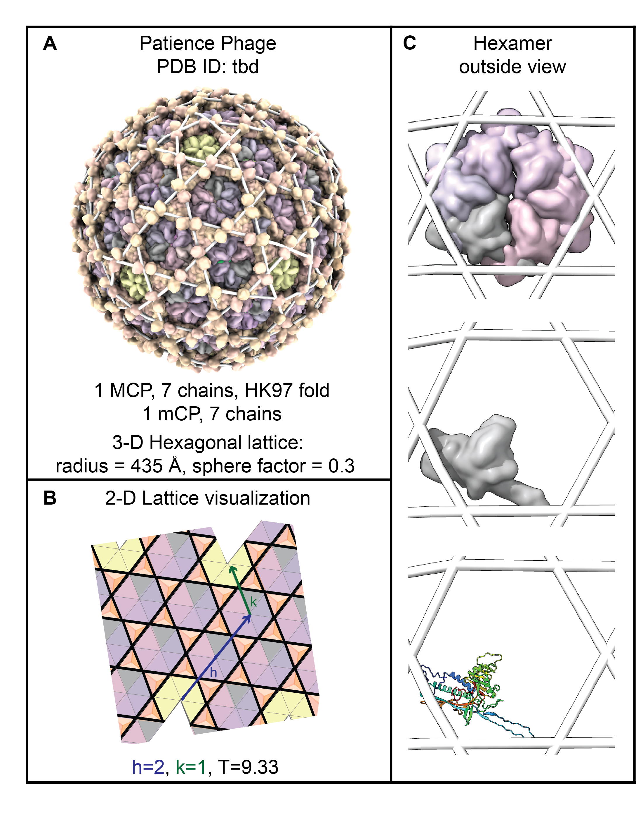
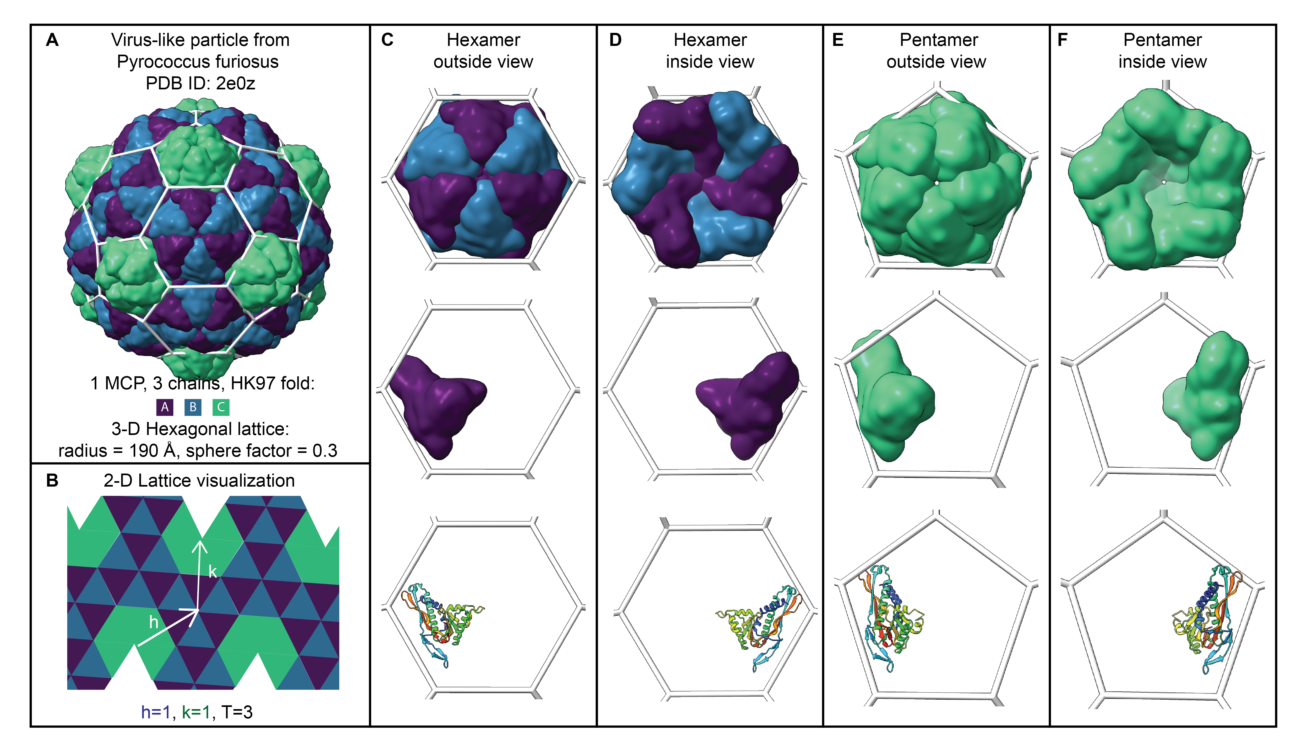
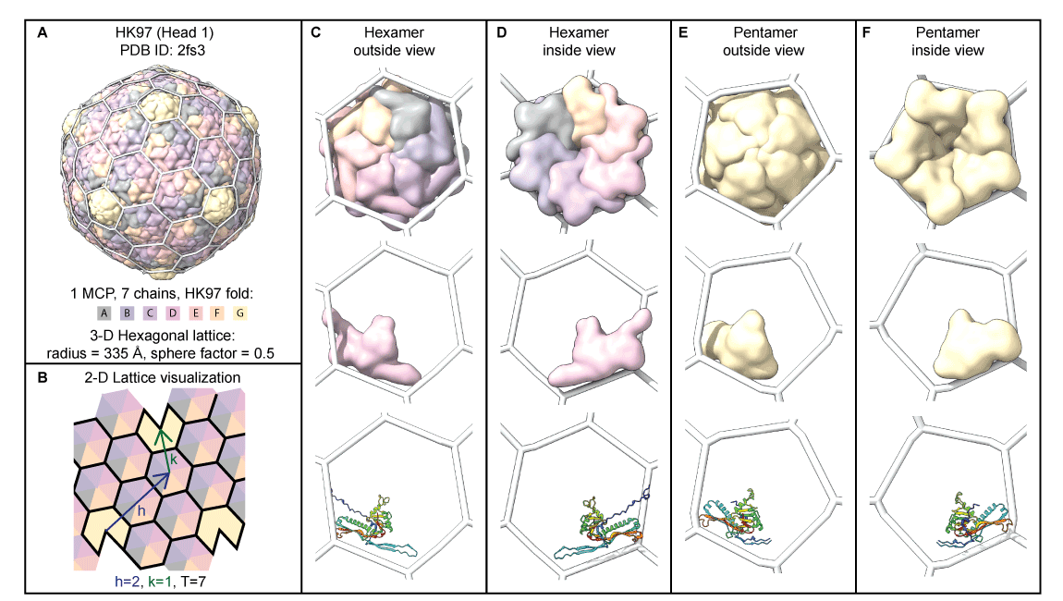
Icosahedral Capsid Anatomy
Lee, Brown, Bartels et al. In Preparation
Notes:
1min
In the lab we’re currently using geometric methods to explore the anatomy of capsids. Core to our method is assuming that proteins group into capsomers that fit within the polygons of 3D Polyhedra. We align the capsid models with a geometric structure created using the hkcage tool in ChimeraX.
The ability to create these 3d structures in the non-hexagonal case was developed by me in my previous work with the lab. This geometric method is done by hand, and sometimes it is not easy to select a specific classification or extract meaningful information. This prompted us to develop a method that is both numerical and mechanical in nature.

Slide 5
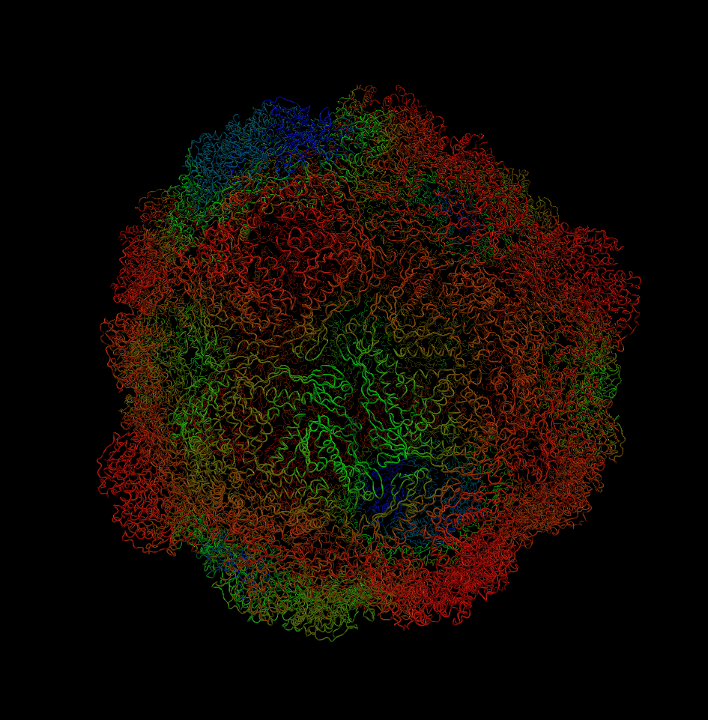
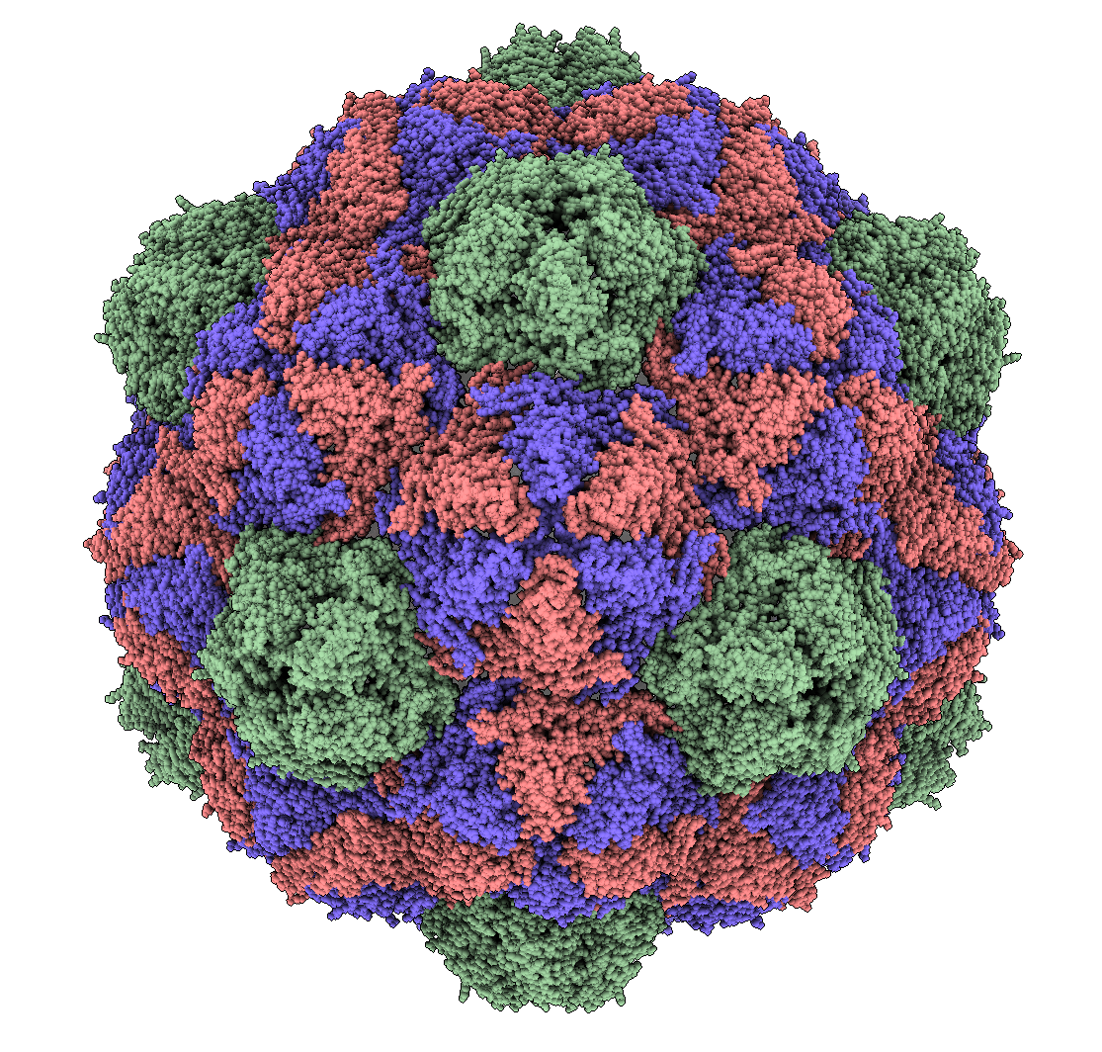
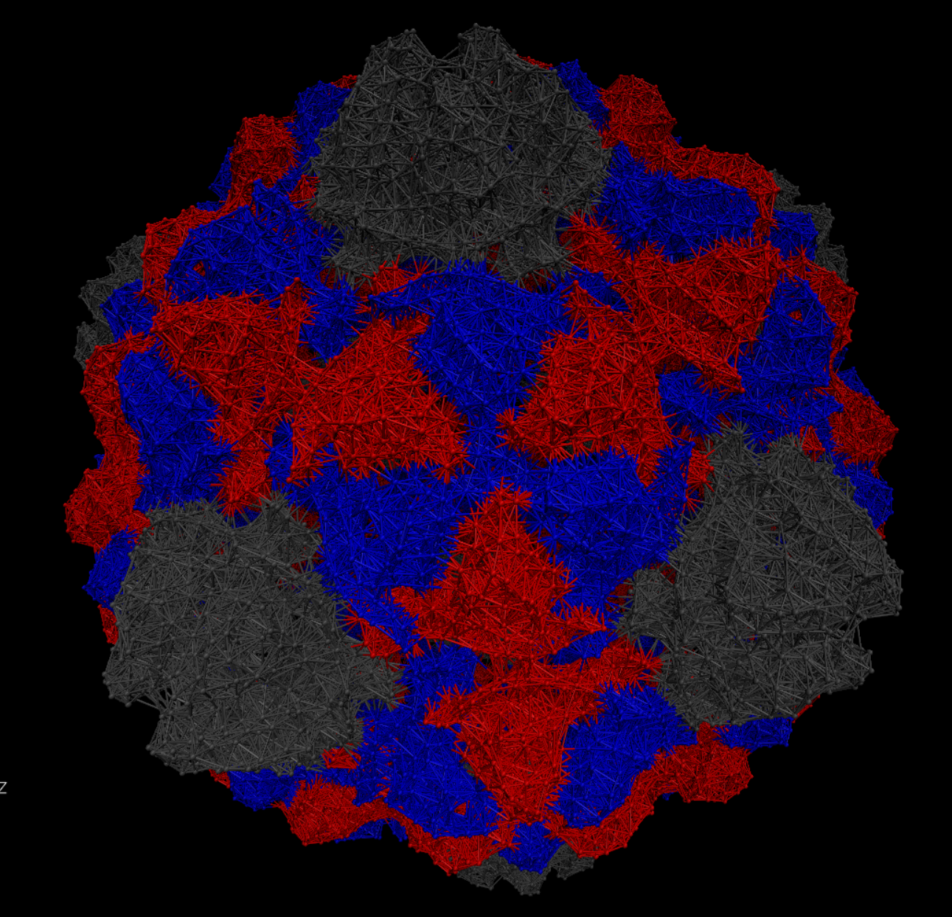
Step 1: Physical Model
Normal Mode Analysis
Atomic model
Elastic Network Model
Brown and Luque, In Preparation
Notes:
1min
We begin with the same atomic models we were using for our geometric analysis, but simplify greatly by using only the Carbon-alpha atoms to build an elastic network model. Representing each of the carbon alpha atoms as a mass connected to nearby atoms by springs. We use a technique called normal mode analysis to determine the equilibrium dynamics of the capsid.

Slide 6
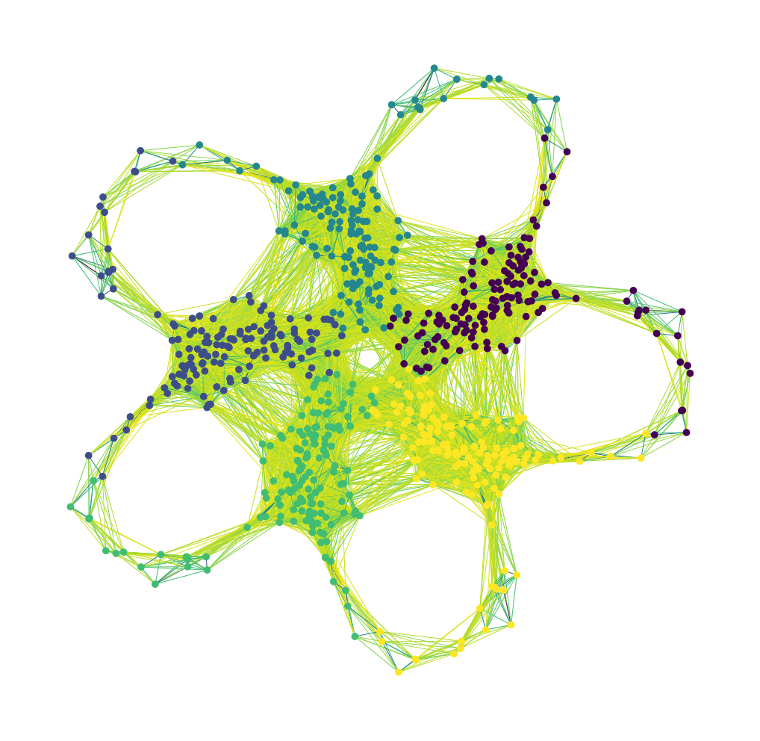
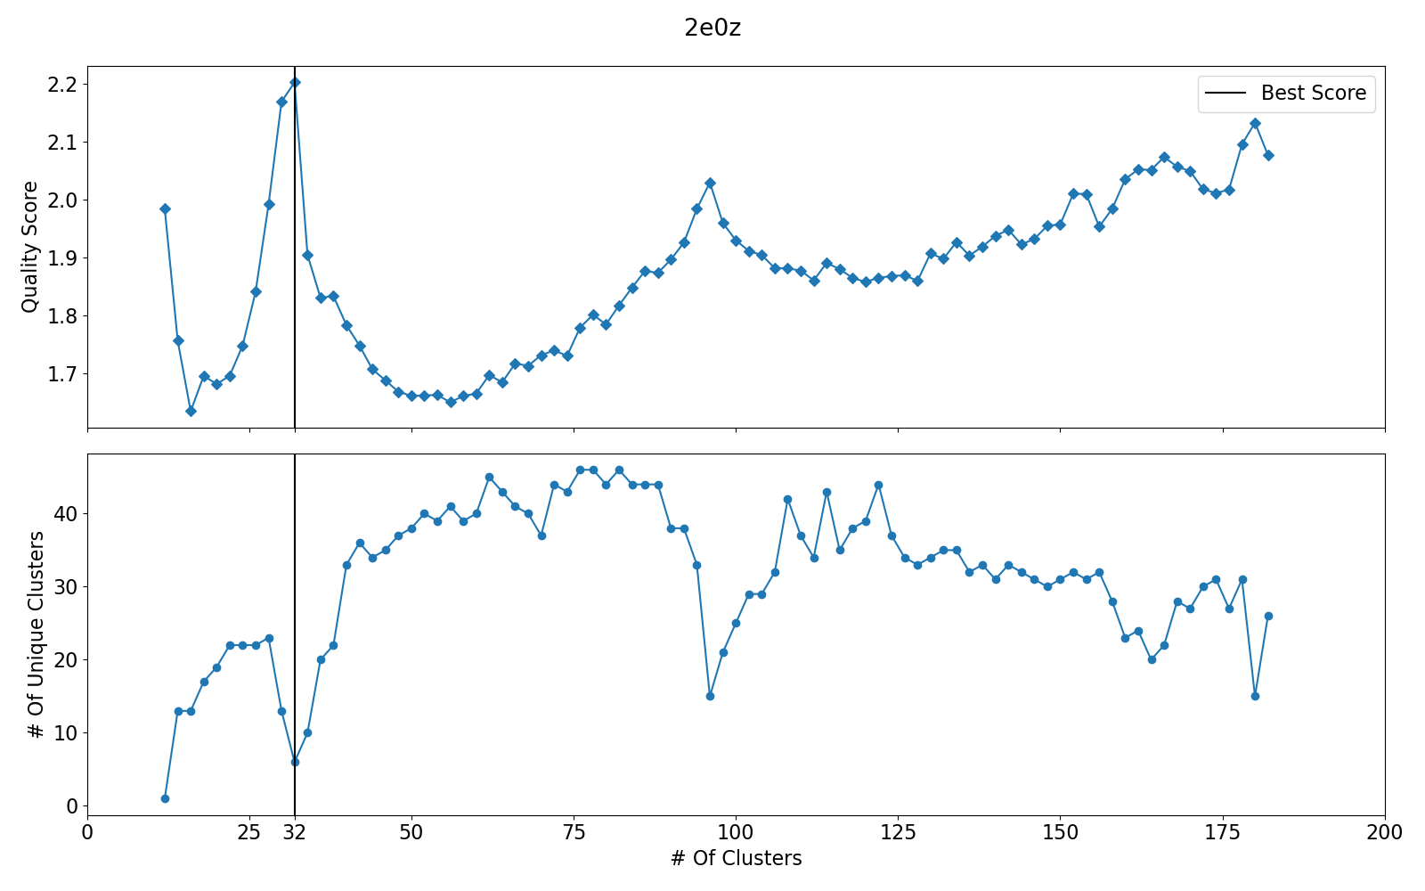
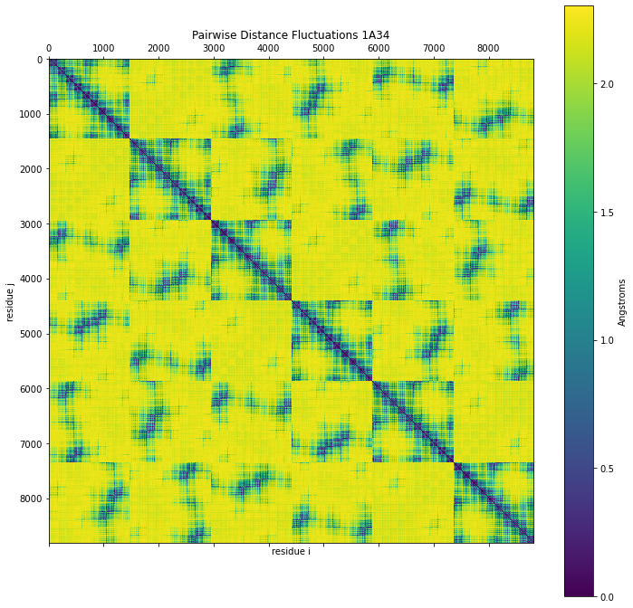
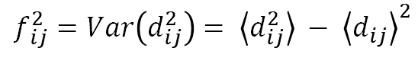
Step 2: Quasi-Rigid Domain Subdivision
Spectral Clustering
Distance Fluctuations From NMA
Scoring & Selection
$$f_{ ij}^{2}=Var\left(d_{ij}^{2}\right)= \left\langle d_{ij}^{2}\right\rangle − {\left\langle d_{ij}\right\rangle }^{2}$$
Brown and Luque, In Preparation
Notes:
1min
Start with the distance fluctuations from Normal Mode Analysis
We identify our capsomers by clustering our distance fluctuations. An efficient method of doing this for large network is a technique called spectral clustering with roots in graph theory. We perform this subdivision for many possible numbers of clusters and select a scoring method to determine the optimal cluster.

Slide 7
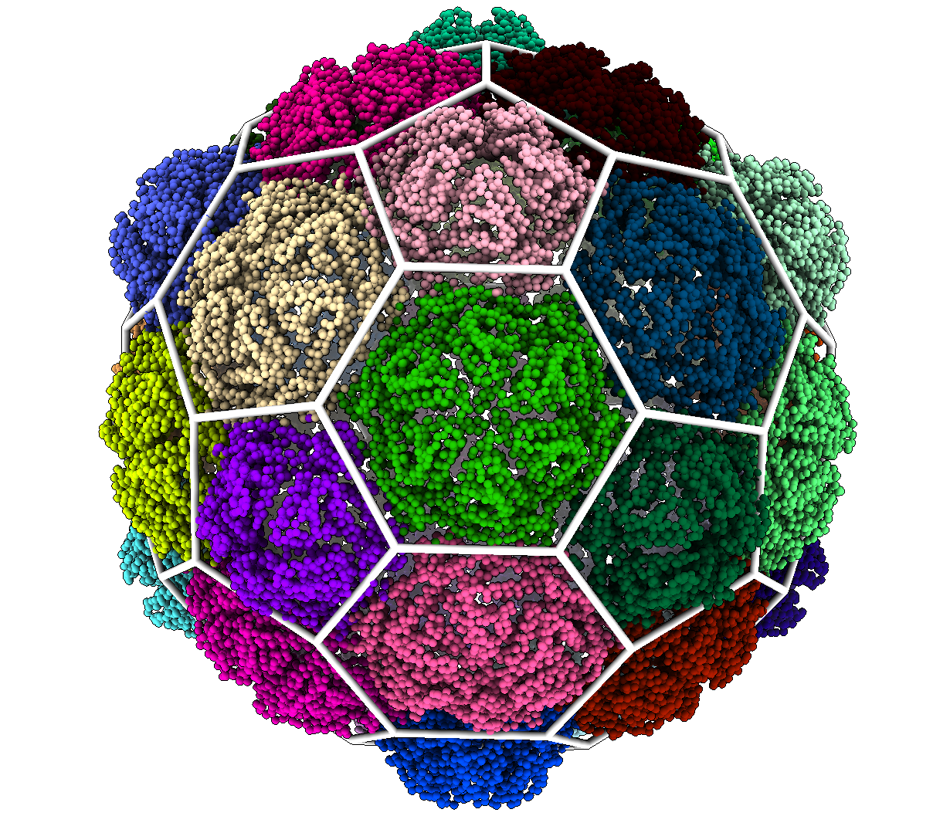
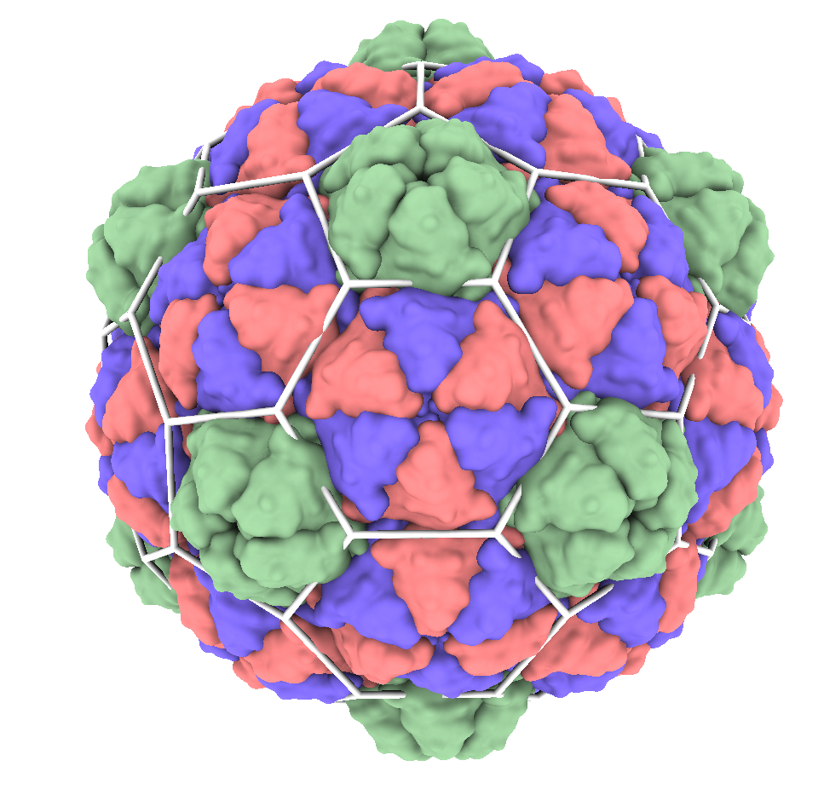
Step 3: Geometrical Classification
Pyrococcus F. Encapsulin
Brown and Luque, In Preparation
Notes:
30 seconds
We then visualize etc…. Using this encapsulin as an example, we overlay the 3d structure onto a capsid colored by its subunits, and try to fit the subunits within the polygons.

Slide 8
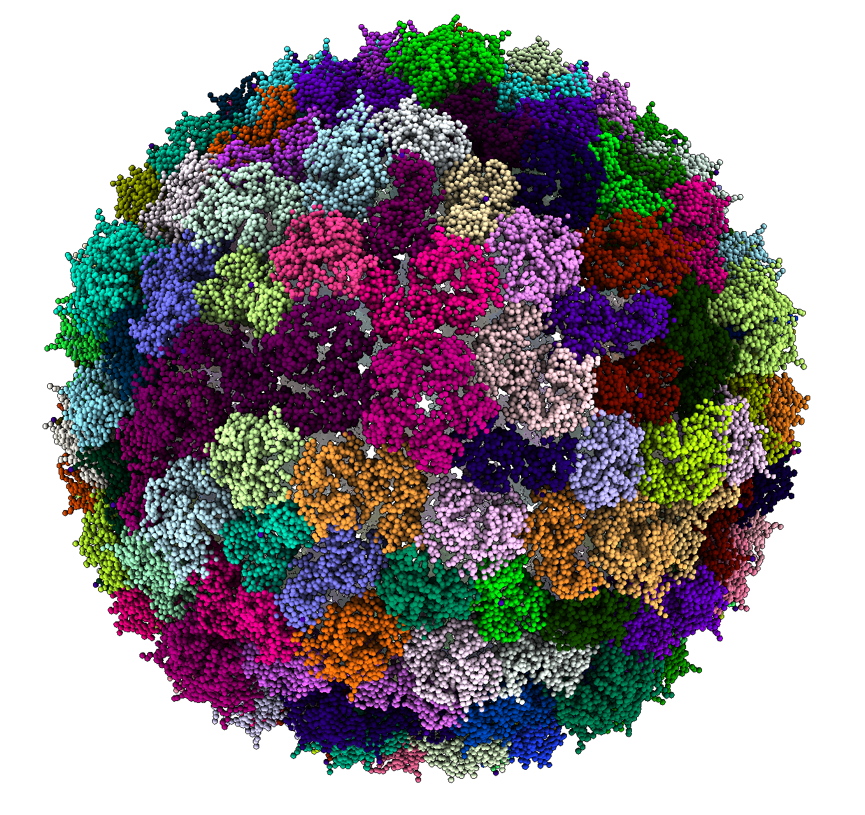
Results Summary
15 Total Structures
7 Hexagonal
4 Encapsulins
2 Trihexagonal
2 Trihexagonal-Dual
4 Uneven Subdivisions (Inconclusive)
Phage 80-alpha - Uneven
Subdivisions
Notes:
1 min
Maybe mention lattices.
These 4 didn’t align to a lattice.
Of the 15 Capsids we analyzed, we were unable to classify 4 due to our method returning uneven subdivisions. Of the 11 we successfully classified, 7 were classified as hexagonal. The smallest 4 out of these 7 were encapsulins. Show Example of Inconclusive.

Slide 9
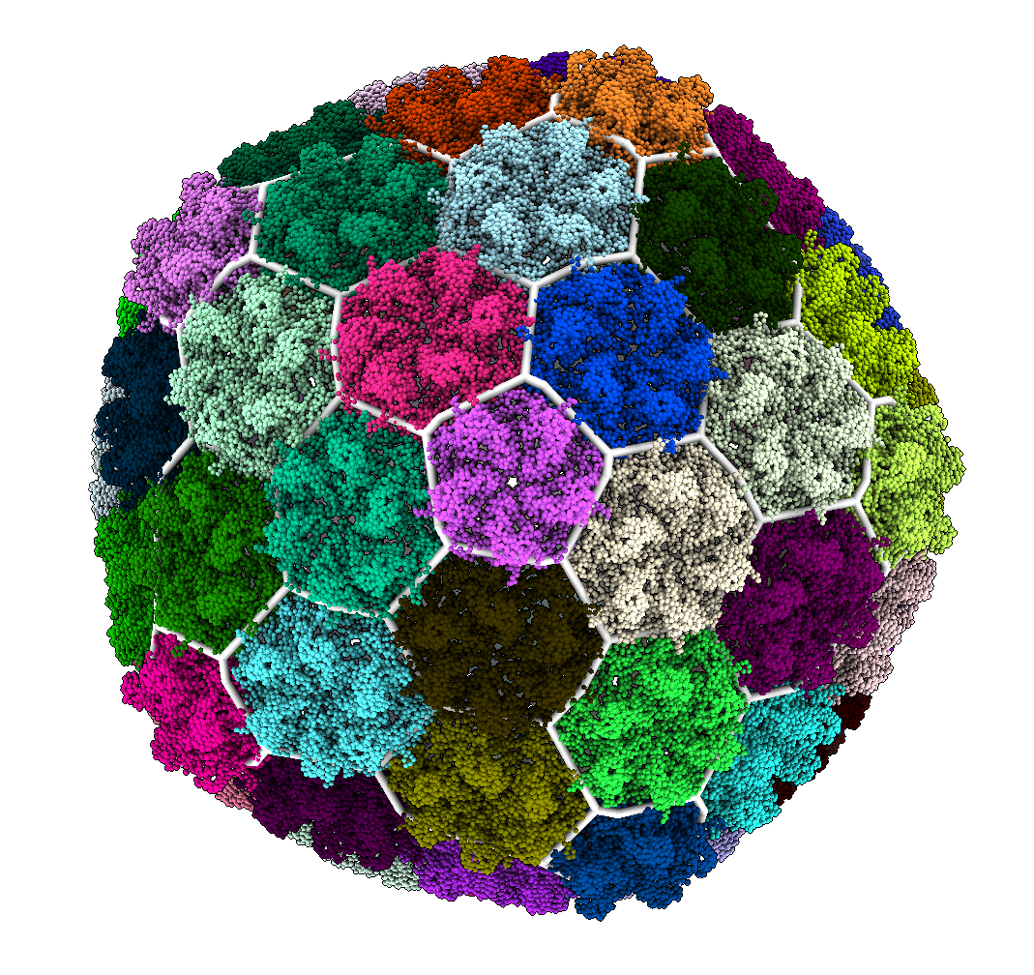
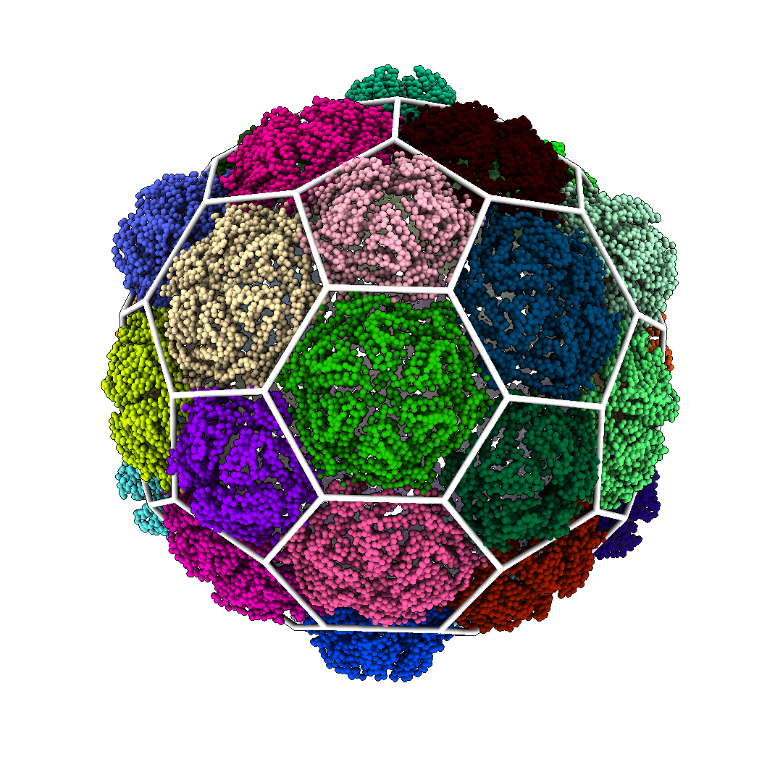
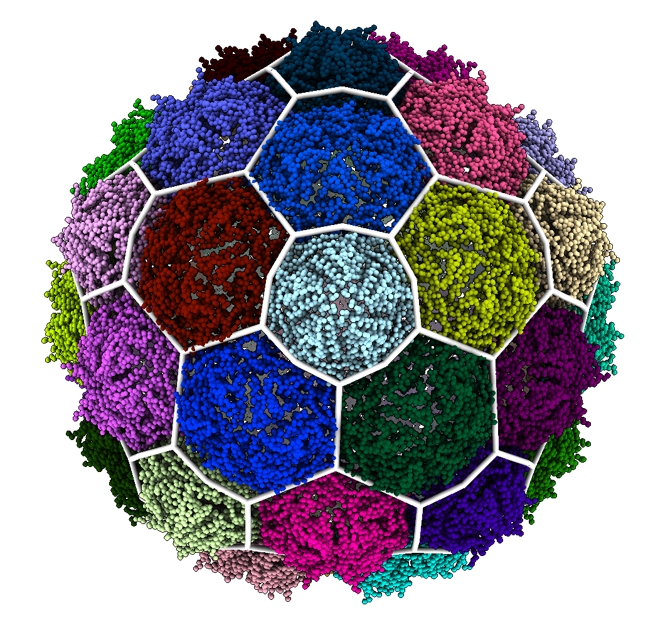
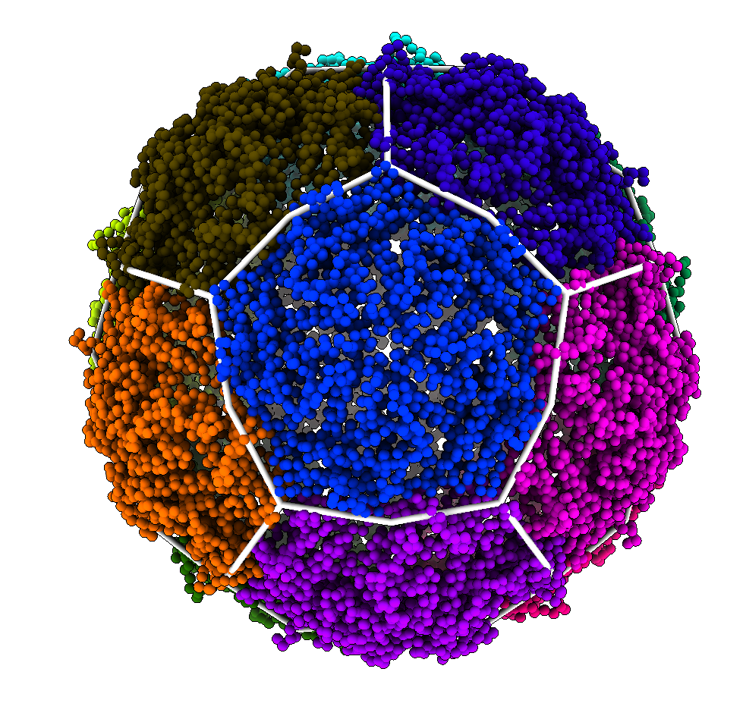
Results – Hexagonal Structures
420 Proteins
180 Proteins
240 Proteins
60 Proteins
Encapsulins
Brown and Luque In Preparation
Notes:
30 sec
The smallest encapsulin had the minimum 60 proteins for an icosahedral structure. The smallest capsid we classified had 420 proteins. Even as the capsids grow in size hk97 folds maintain this hexagonal structure unless additional proteins are added to the capsid surface.

Slide 10
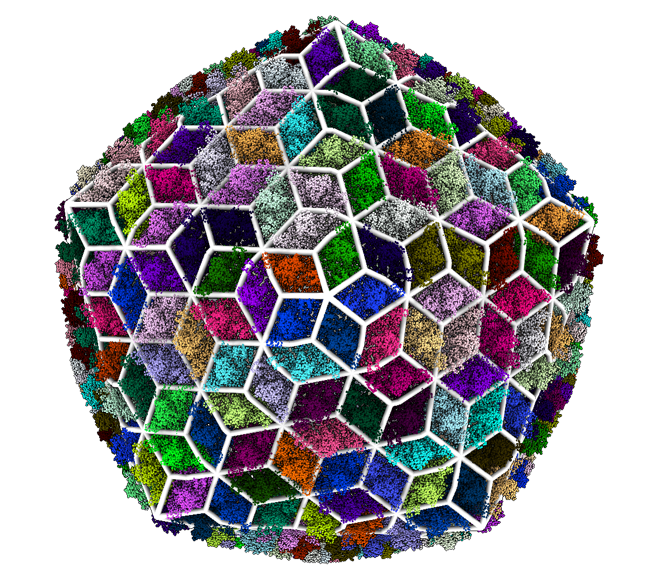
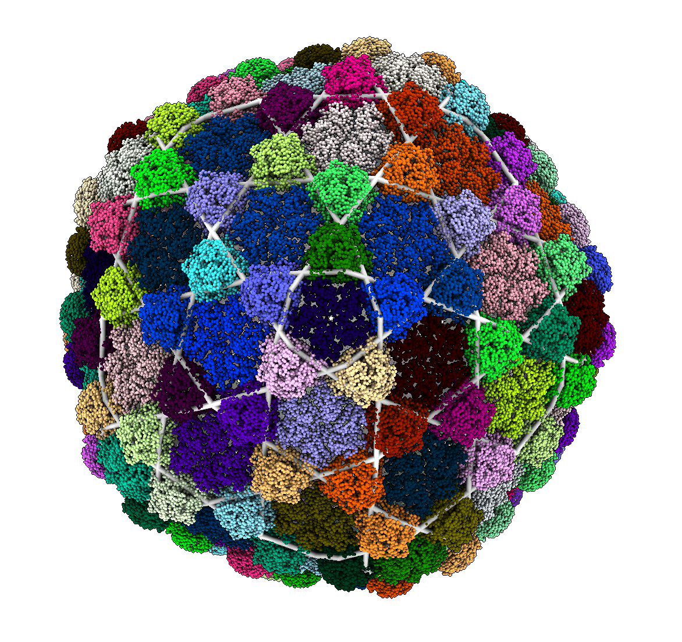
Results – Reinforcement Proteins
780 Major Proteins
260 Reinforcement Proteins
420 Major Proteins
140 Reinforcement Proteins
Brown and Luque In Preparation
Notes:
1min
Some of the capsids incorporate additional reinforcement proteins. These capsids were classified as either trihexagonal or trihexagonal-dual using out method, depending on whether the reinforcement proteins are present at the 2-fold or 3-fold axes. Capsids using these reinforcement proteins tend to be larger and more stable. When these reinforcement proteins are removed, the structures are still classified as hexagonal, indicating that the underlying structure remains relatively unchanged.
Don’t overexplain

Slide 11
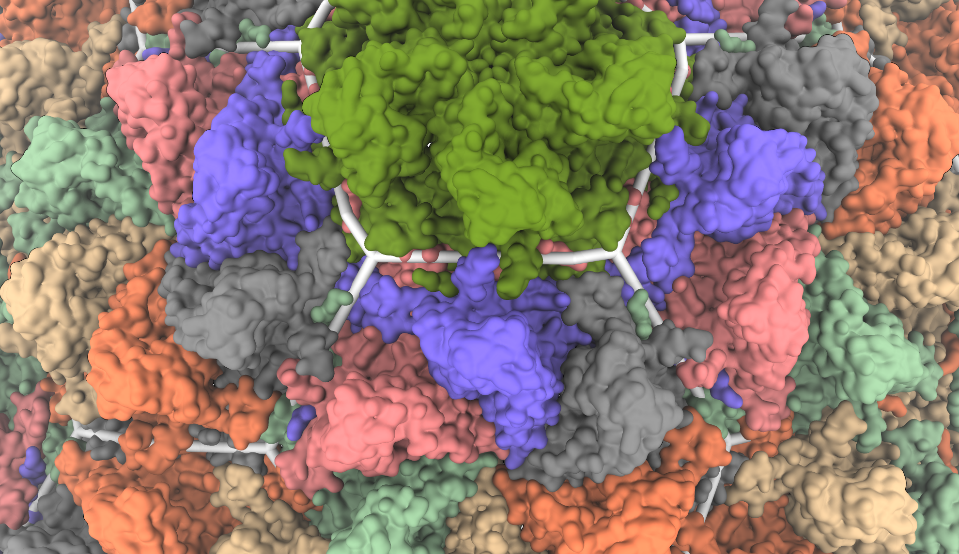
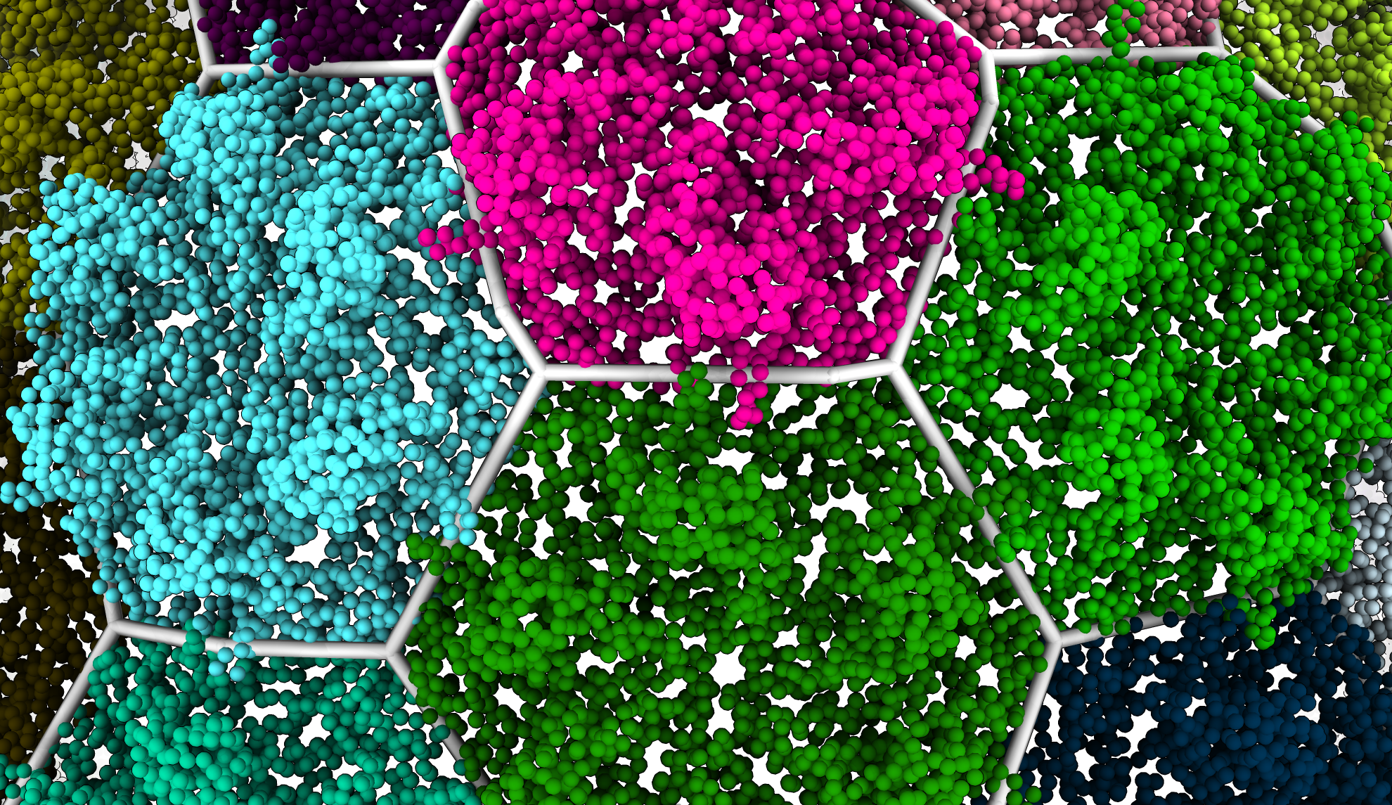
Results - Crossing Domains
Bacteriophage P22
Brown and Luque, In Preparation
Notes:
1min
Don’t overexplain.
When looking at the capsid with the proteins colored, we see that some domains cross the border of the cluster. In this case of P22 we identify the D-Loops (use pointer) crossing the 2-fold axis, and the N-terminal arm (again pointing at fig). Our results show the D-loop as part of the same subunit as the rest of their protein. The N-terminal arm however is identified as part of the capsomer it crosses into.

Slide 12
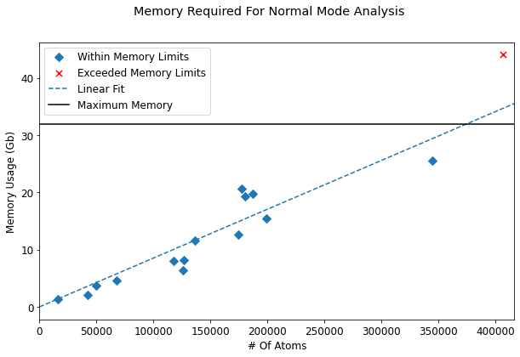
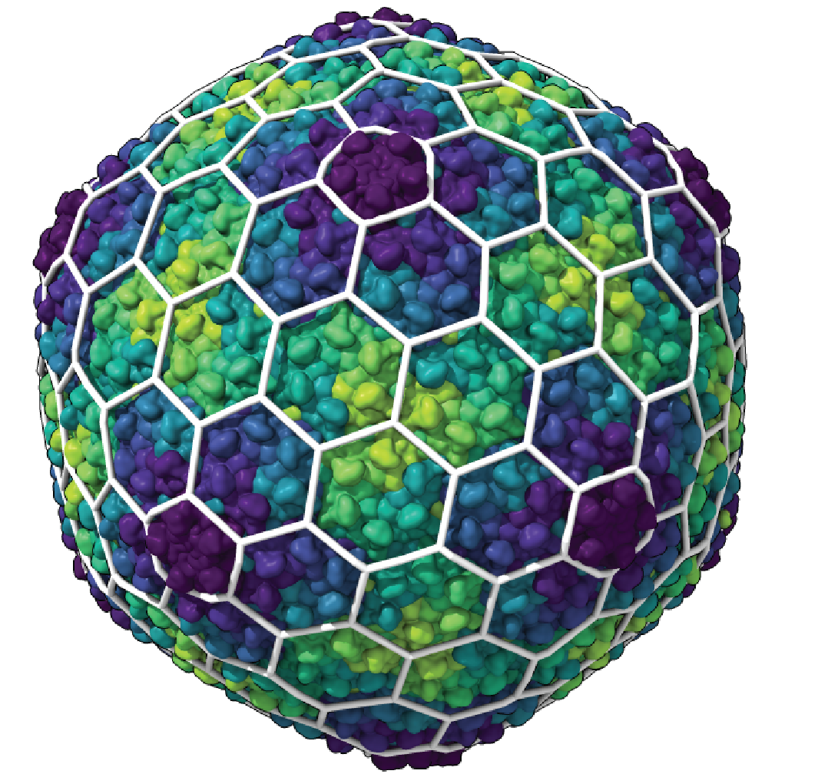
Memory Limitations
Limit of 32 Gb ≈ 380,000 Atoms
Brown and Luque
In Preparation
Isometric Phage T4
Exceeded Memory Requirements
Notes:
1 min
The Normal Mode Analysis step is very memory intensive and is the biggest limitation for our method. We use a machine with 32 Gb of RAM and this is more than enough for the encapsulins and intermediate sized capsids. But based on our data this means we will be unable to analyze capsids with more than 380,000 alpha carbon atoms without finding a way to reduce these memory requirements. These limitations have already prevented us from analyzing Isometric Phage T4, which was planned to be in our first batch of results.

Slide 13
Conclusion
HK97-Fold
Hexagonal Structure
Reinforcement Proteins
Extended Domains
Classification Method
Larger Capsids - Reduce Memory Requirements
Symmetry
Modularity
Physical Models
Clustering Algorithms
Notes:
1 min
HK97 capsids universally adopt a hexagonal lattice, and are classified as hexagonal unless additional proteins are present on the surface. These additional proteins don’t modify the underlying lattice but may allow the capsid to expand further. Our method was able to distinguish overlapping protein domains in HK97 capsids.
If we want to analyze larger capsids we need to reduce our memory requirements. One way to do so could be using Icosahedral Symmetry Constraints. The method could be made modular, and we can explore the usage of alternate physical models and alternate clustering algorithms.

Slide 14

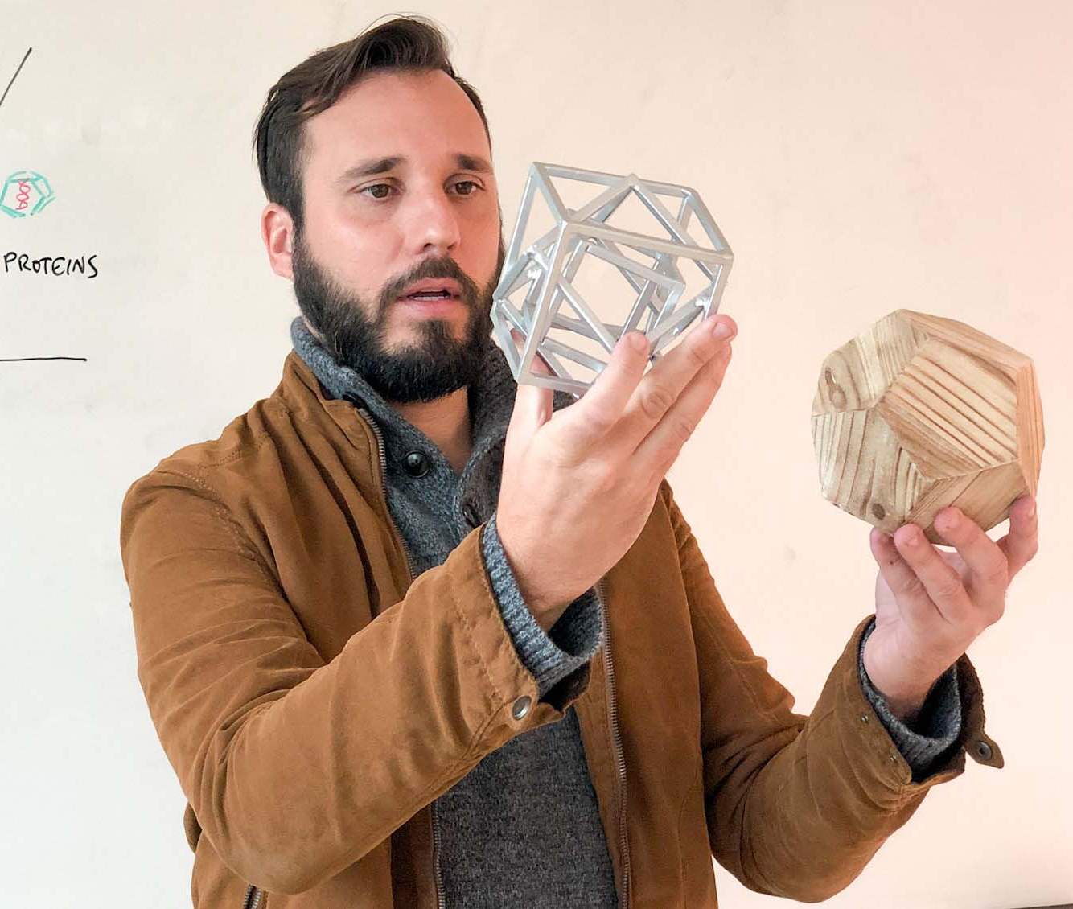









Acknowledgements
Luque Lab
Antoni Luque
Diana Lee
Brandon Ricafrente
Caitlin Bartels
Aurora Vogal
Vaishnavi Patel
Anuradha Agarwal
Meghan Osato
Grant # 1951678
UC San Francisco
ChimeraX Development Team
Tom Goddard
https://doi.org/10.37807/GBMF9871

Slide 15
Questions
Notes:
Ask if I should put contact info

Slide 16
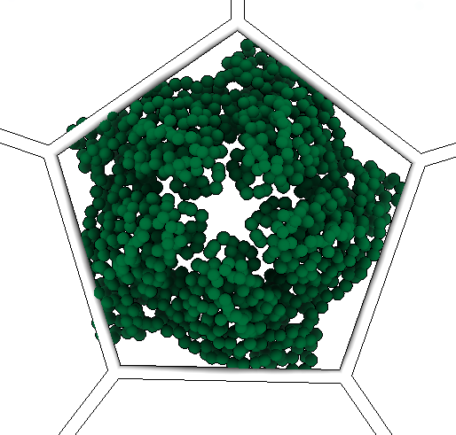
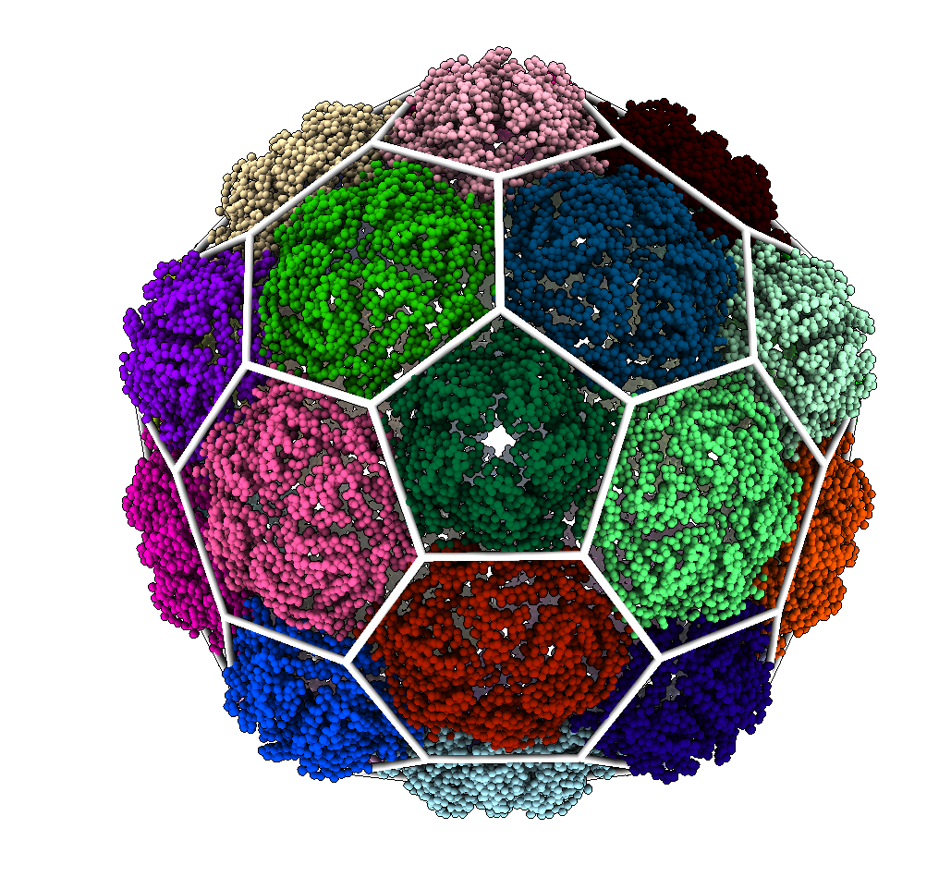
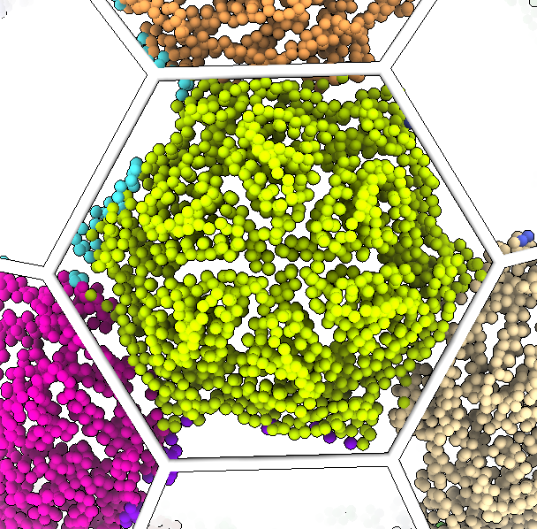
Results – Comparison With Geometric
Notes:
1min
When examining a simple hexagonal capsid we see that our method matches our geometric analysis well. However, some residues on the edge of proteins are assigned to adjacent clusters.

Slide 17
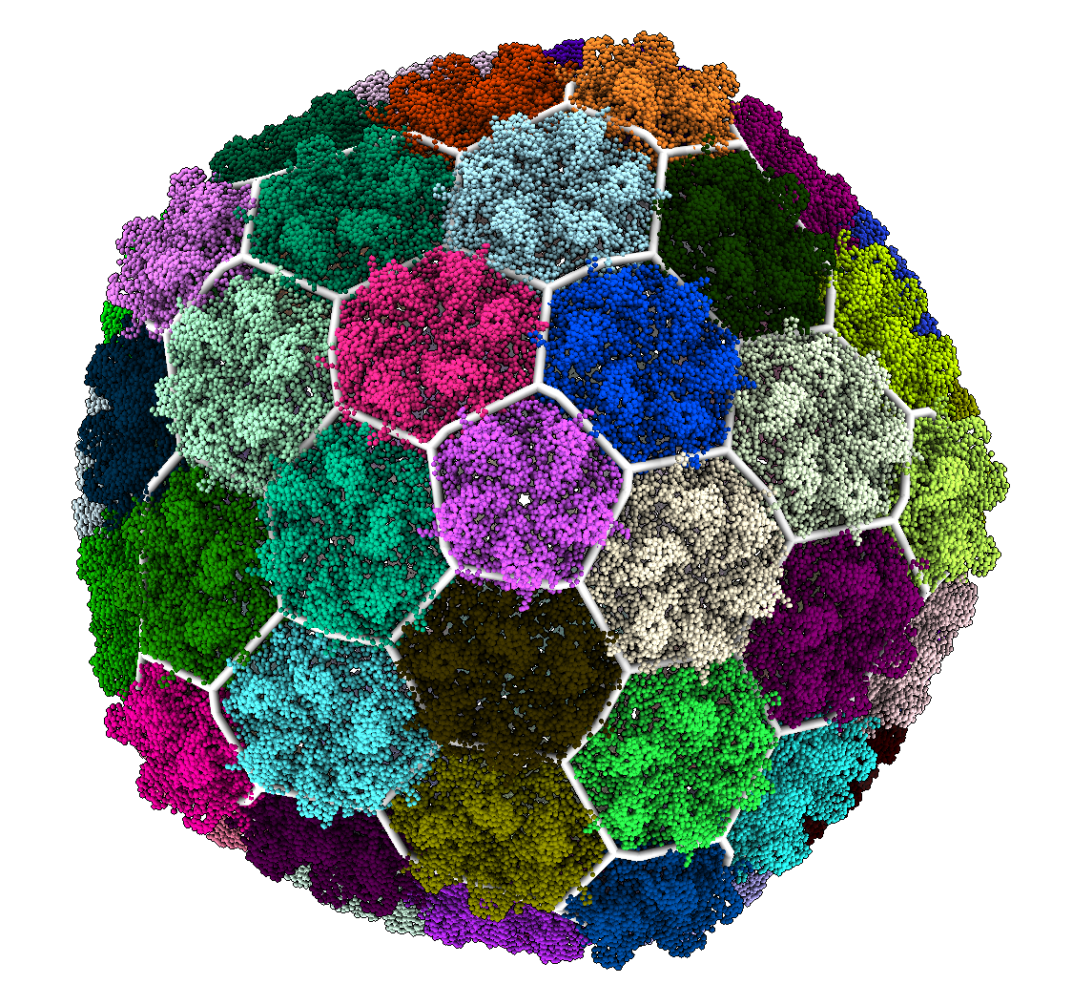
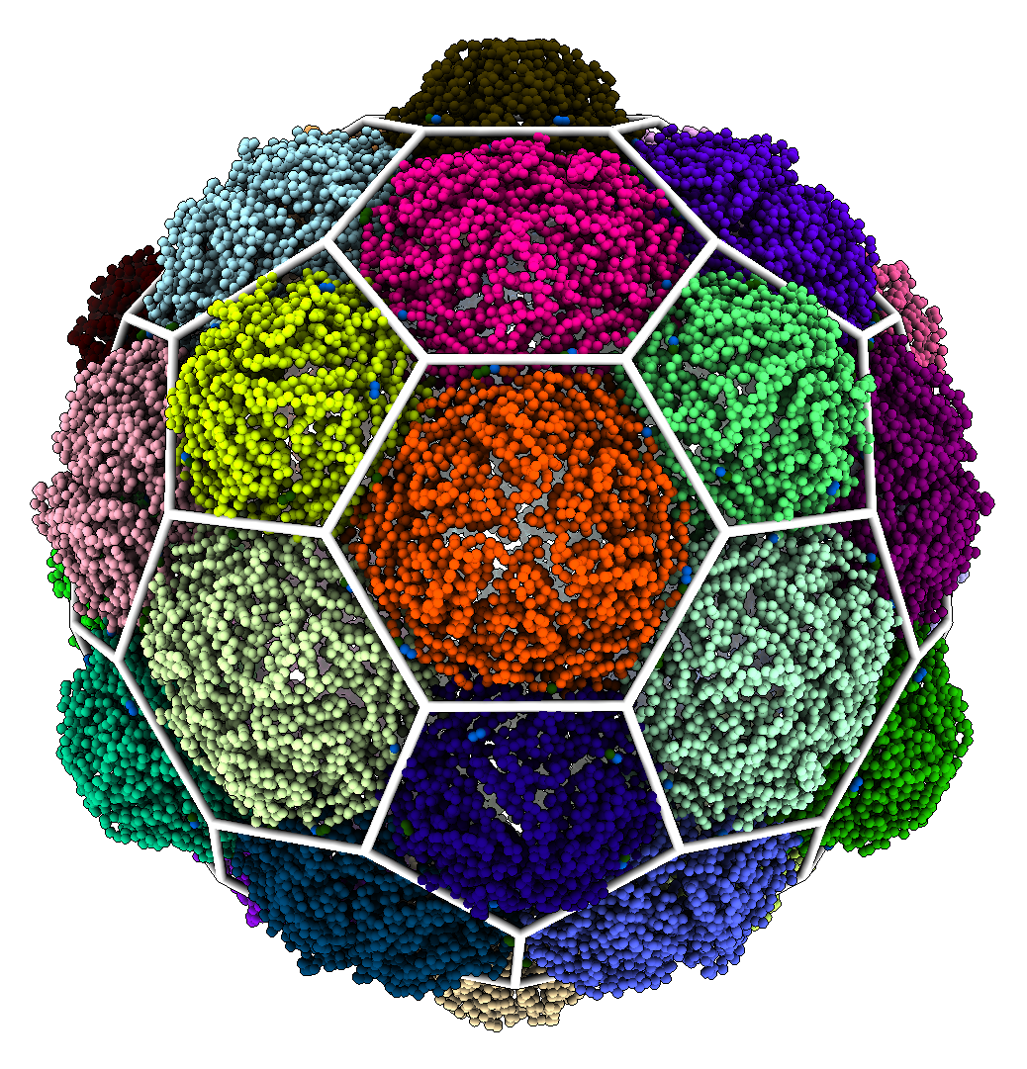
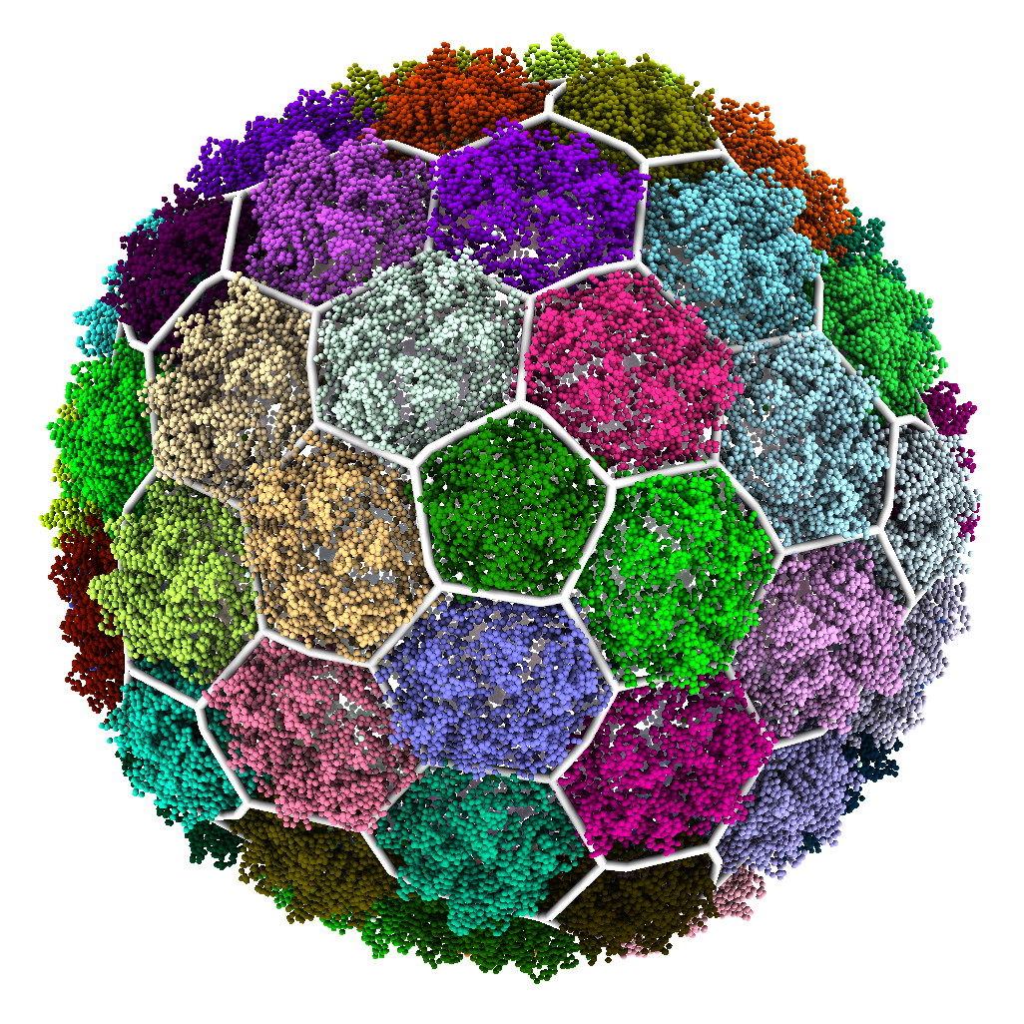
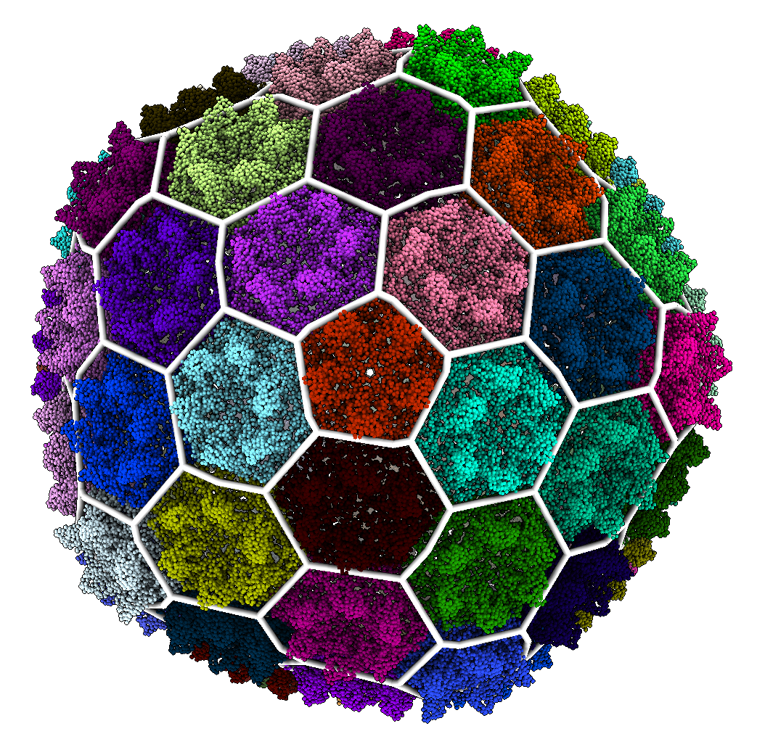
Results - Hexagonal
60 MCPs
180 MCPs
240 MCPs
420 MCPs

Slide 18
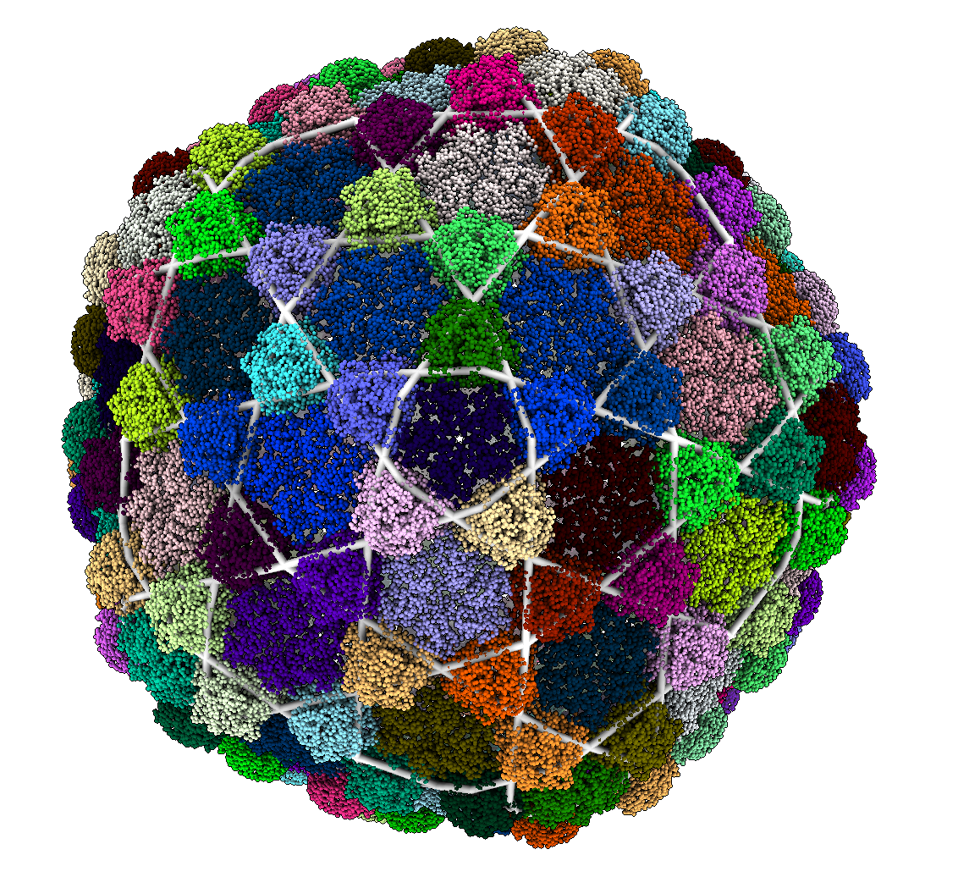
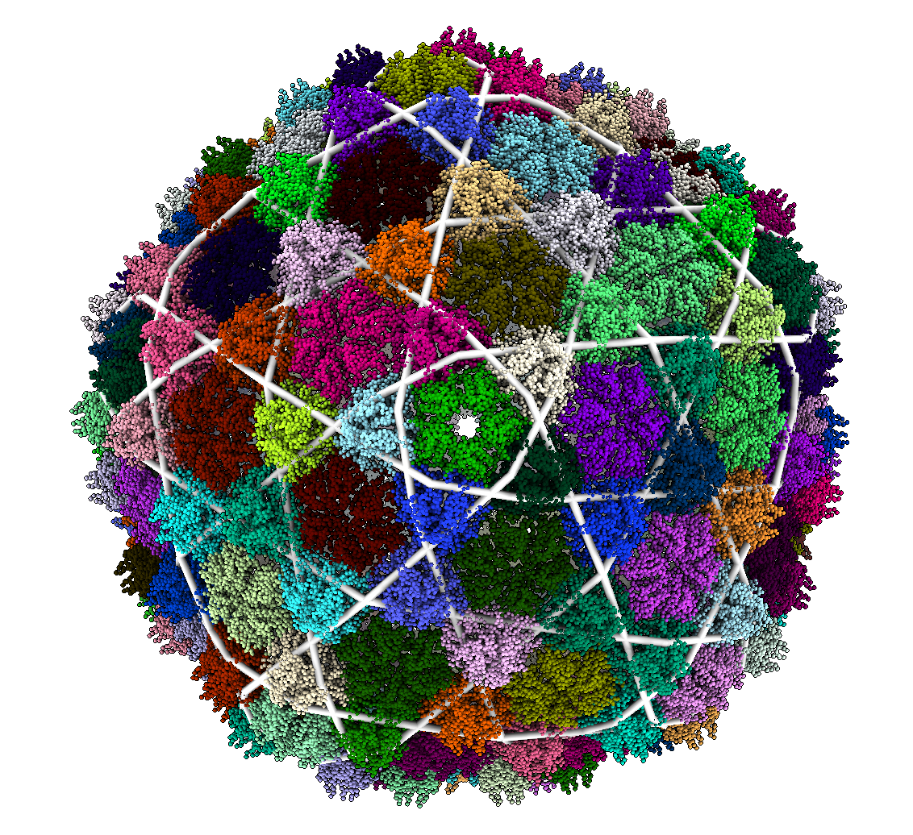
Results – Trihexagonal
420 MCPs & 140 Reinforcement Proteins

Slide 19
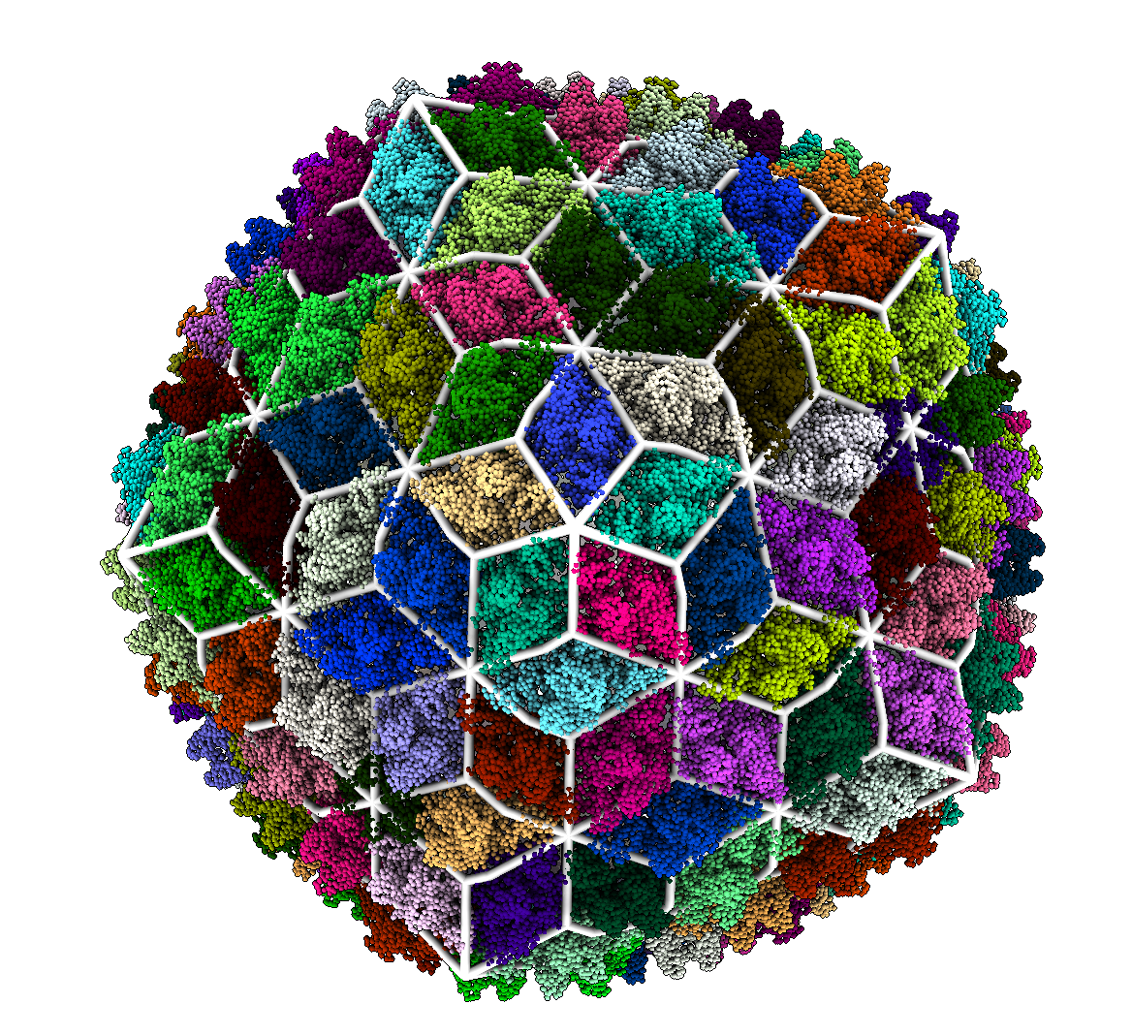
Results – Trihexagonal-Dual
780 MCPs & 260 Reinforcement Proteins
420 MCPs & 140 Reinforcement Proteins

Slide 20
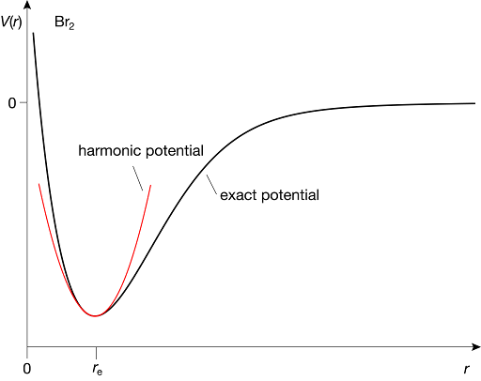
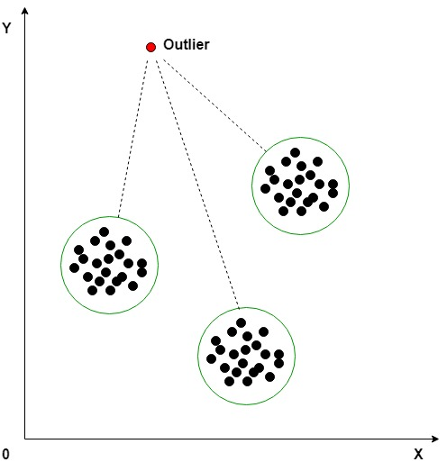
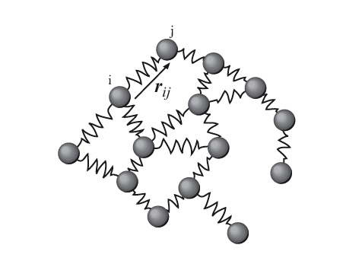
Model Assumptions & Limitations
Harmonic
Potentials
No Outlier Removal
ENM Coarse Graining
Subdivision Selection
Notes:
1min
We assume all potentials are harmonic and lose information on specific chemical bonds. We coarse grain the system to the level of individual residues missing detailed subunit interaction. We do not remove outliers and thus may include domains that are in no way rigid. Selecting the optimal subdivision requires a scoring metric and is a complex problem.
Talk to Diana a little, source the images.

Slide 21
Atomic model
Elastic Network Model
Normal modes analysis
Icosahedral lattice assignment
Scoring Subdivision
Eyal et al Bionformatics 2006
Bahar et al Chem Rev 2010
Polles et al. PLoS Comp Bio 2013
Ponzoni et al Structure 2015
Brown^{M} and Luque, In Preparation
Notes:
2min

Slide 22
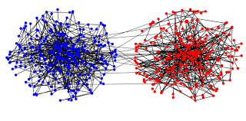
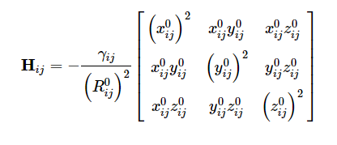
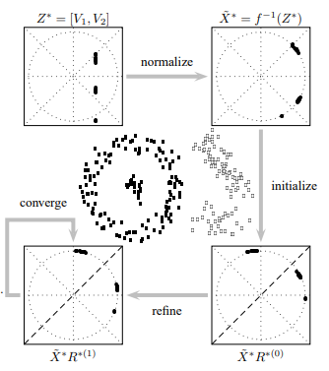
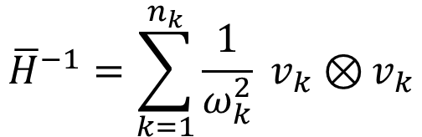
Performance
Constructing
Hessian
# Of Modes
Calculate Normal
Modes
$${\overline{H}}^{−1}=\sum_{k=1}^{n_{k}}{\frac{1}{ω_{k}^{2}} v_{k}⊗}v_{k}$$
Eigenvectors/Normal Modes
Lowest Frequencies
Yu, Shi, IEEE 2003
Notes:
1 min
4 main steps
Construct the hessian
Calculate Modes
Spectral Embedding
Clustering via Discretize

Slide 23
Capsid | T # | Additional Proteins | Result
Th. Maritima | 1 | None | Hexagonal
Pyr. Furiosus | 3 | None | Hexagonal
Myx. Xanthus | 3 | None | Hexagonal
Quasi. Thermo. | 4 | None | Hexagonal
P22 Mature | 7 | None | Hexagonal
Phage Sf6 | 7 | None | Hexagonal
Phage T7 | 7 | None | Hexagonal
Bordetella | 7 | 2-Fold Axis | Trihex-dual
Siphov. Mic1 | 7 | 2-Fold Axis | Trihex-dual
Sipho. TW1 | 7 | 3-Fold Axis | Trihexagonal
YSD1 Phage | 7 | 3-Fold Axis | Trihexagonal
Sipho TW1 | 13 | 2-Fold Axis | Trihex-dual

Slide 24
Quasi-Rigid Domain Decomposition
We implement the method described in (Ponzoni & Polles 2015) to identify quasi-rigid domains
Represent the capsid using an Elastic Network Model (ENM)
Apply Normal Mode Analysis to approximate the pairwise distance fluctuations between residues
Use Spectral Clustering techniques to optimally divide the capsid into quasi-rigid domains
Visualize the result and assign a geometric classification based on the clusters

